Slide 1
Project Ascend: Carbon V
Ricky Alcaraz
Jose Rincon
Daniel Hernandez
Saul Gonzalez
Vereniz Rincon

Slide 2
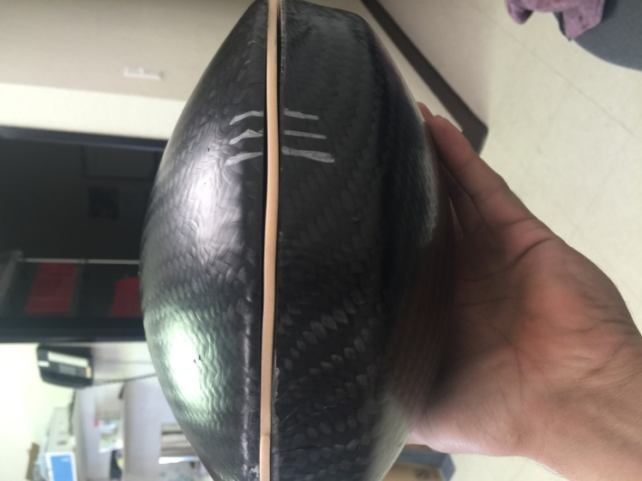
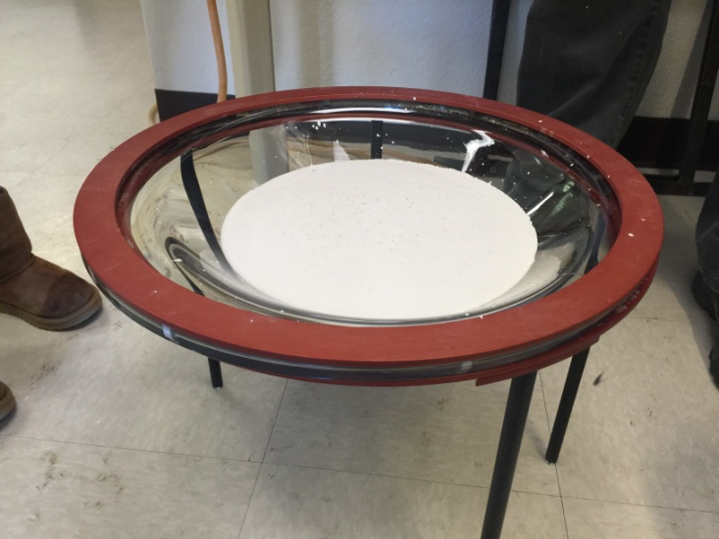
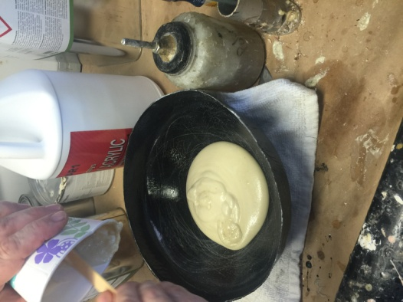
Strength of payload tested
After taken off mould, carbon fiber shell was still somewhat flexible
To give it durability, hard insulation was added
Final product of the Carbon Fiber payload
Insulation cloth placed between both parts of payload for it to stay secured when closed tight

Slide 3
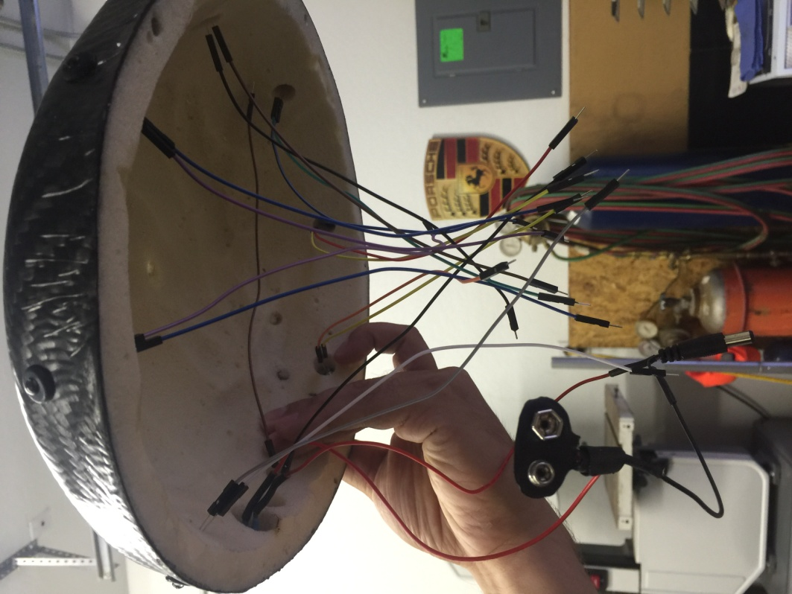
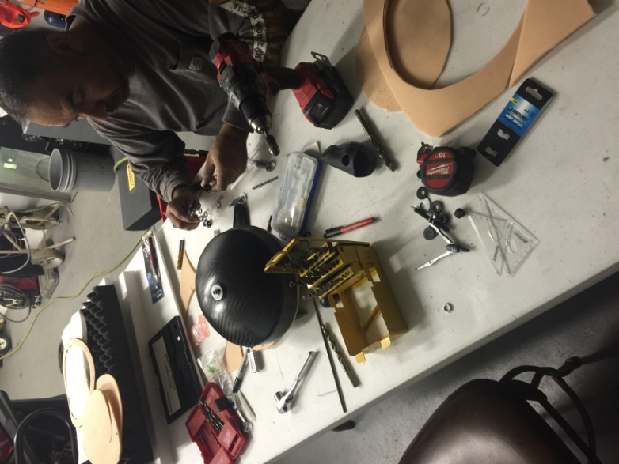
Construction of the interior of the payload

Slide 4
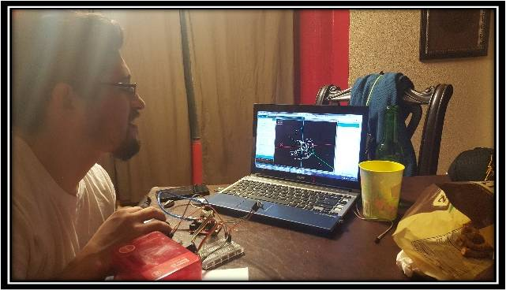
Software
Extensive research was done to customize the libraries to what we want them to do.
Sensors used: Pressure, Exterior Temperature, Real Time Clock, and Magneto Meter

Slide 5
Reflection of Launch
The design of the payload was undamaged
The setup for the interior was stable and durable
Everything was intact and in the exact same position after launch
Problem with the precision of circuitry wiring

Slide 6
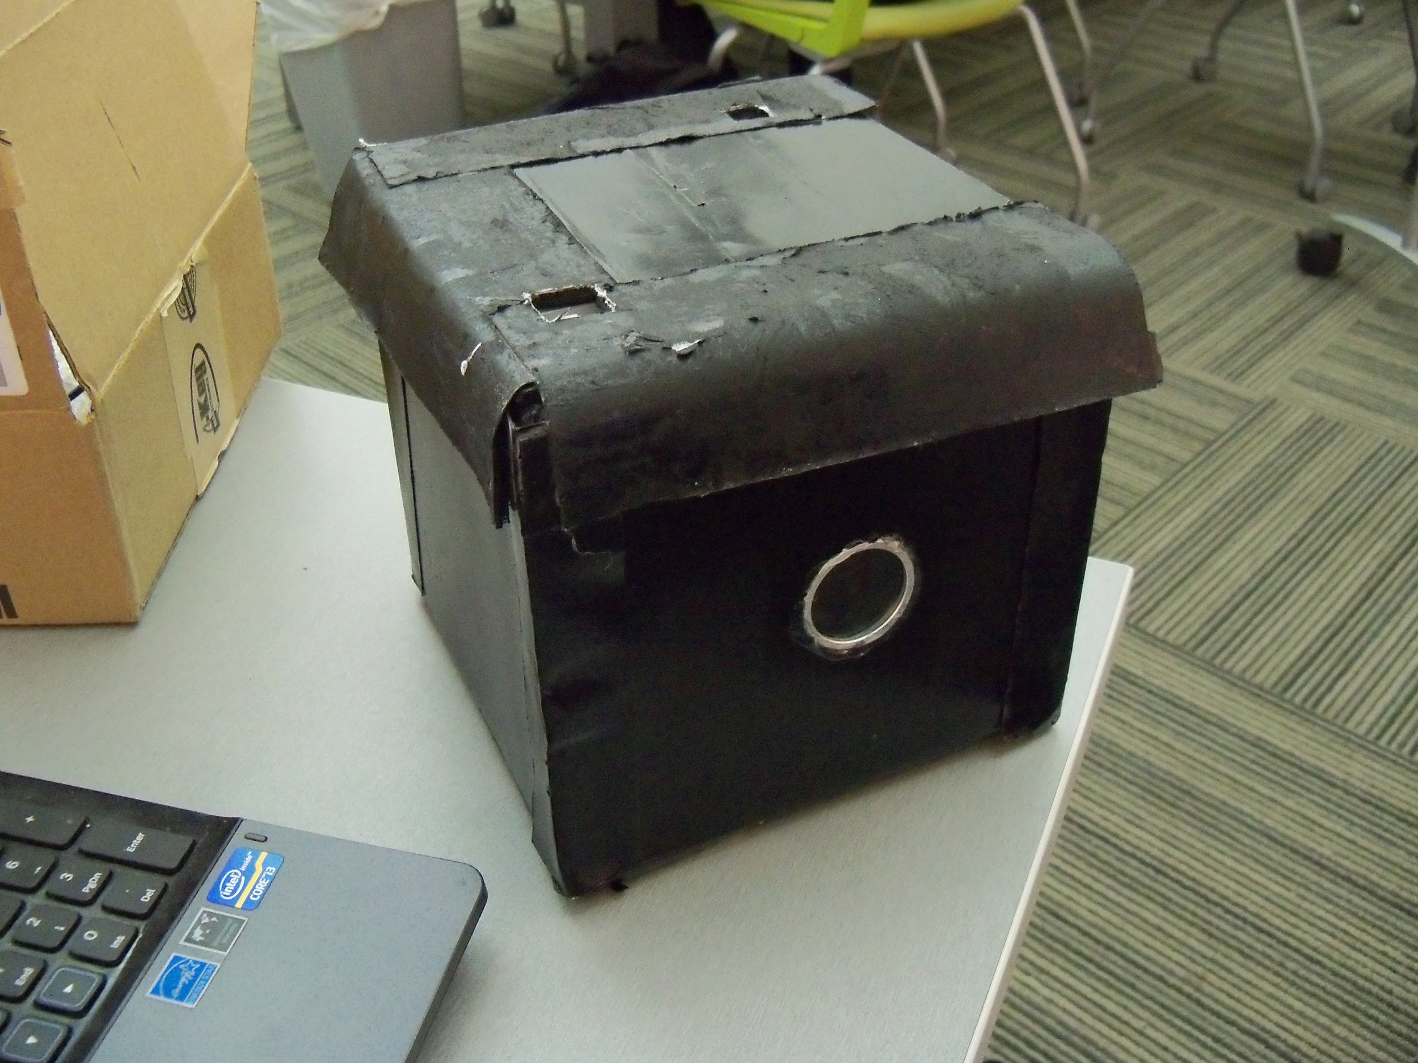
Team Rocket Weather Station
By: Leroy, Tommy ,Andrey, Nick, Lucas, Jonathan

Slide 7
Objective:
The objective of the team rocket weather station is determine the direction of flight , concentration level of hydrogen ,ozone, and nitrogen within the stratosphere, and determine the altitude, pressures, and temperature along the trip. With this information we expect to get a clear understanding of different relationships between pressure, temperature, altitude, and concentration levels in the stratosphere .

Slide 8
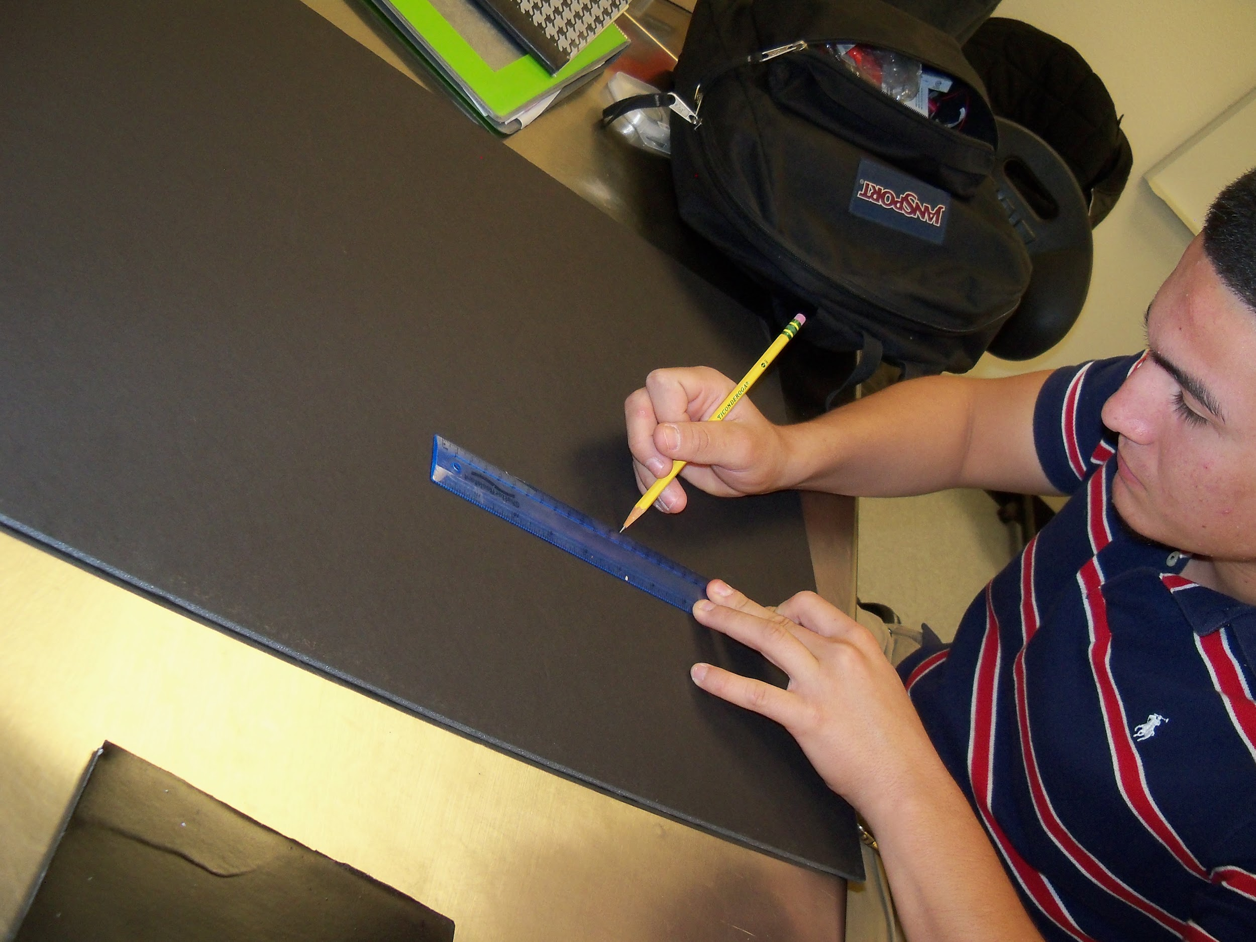
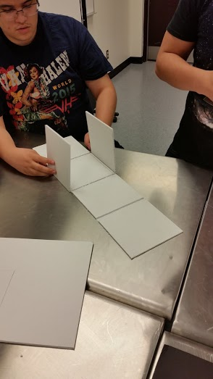
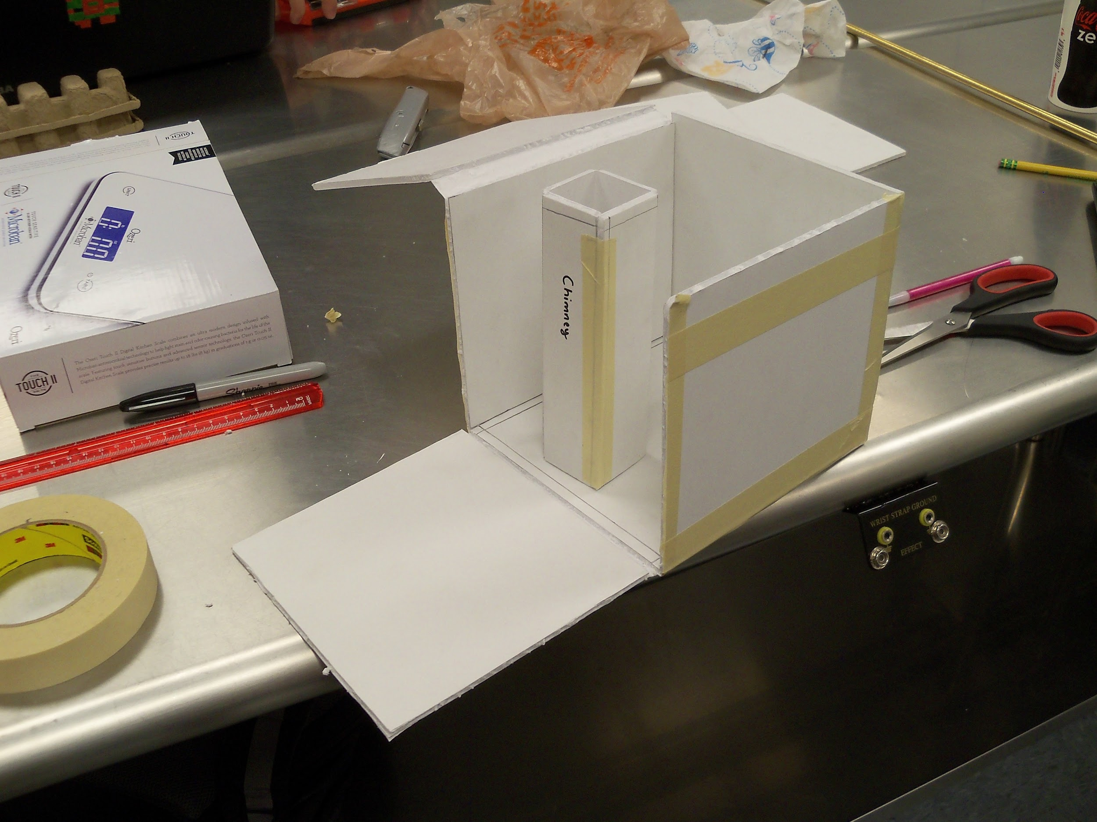
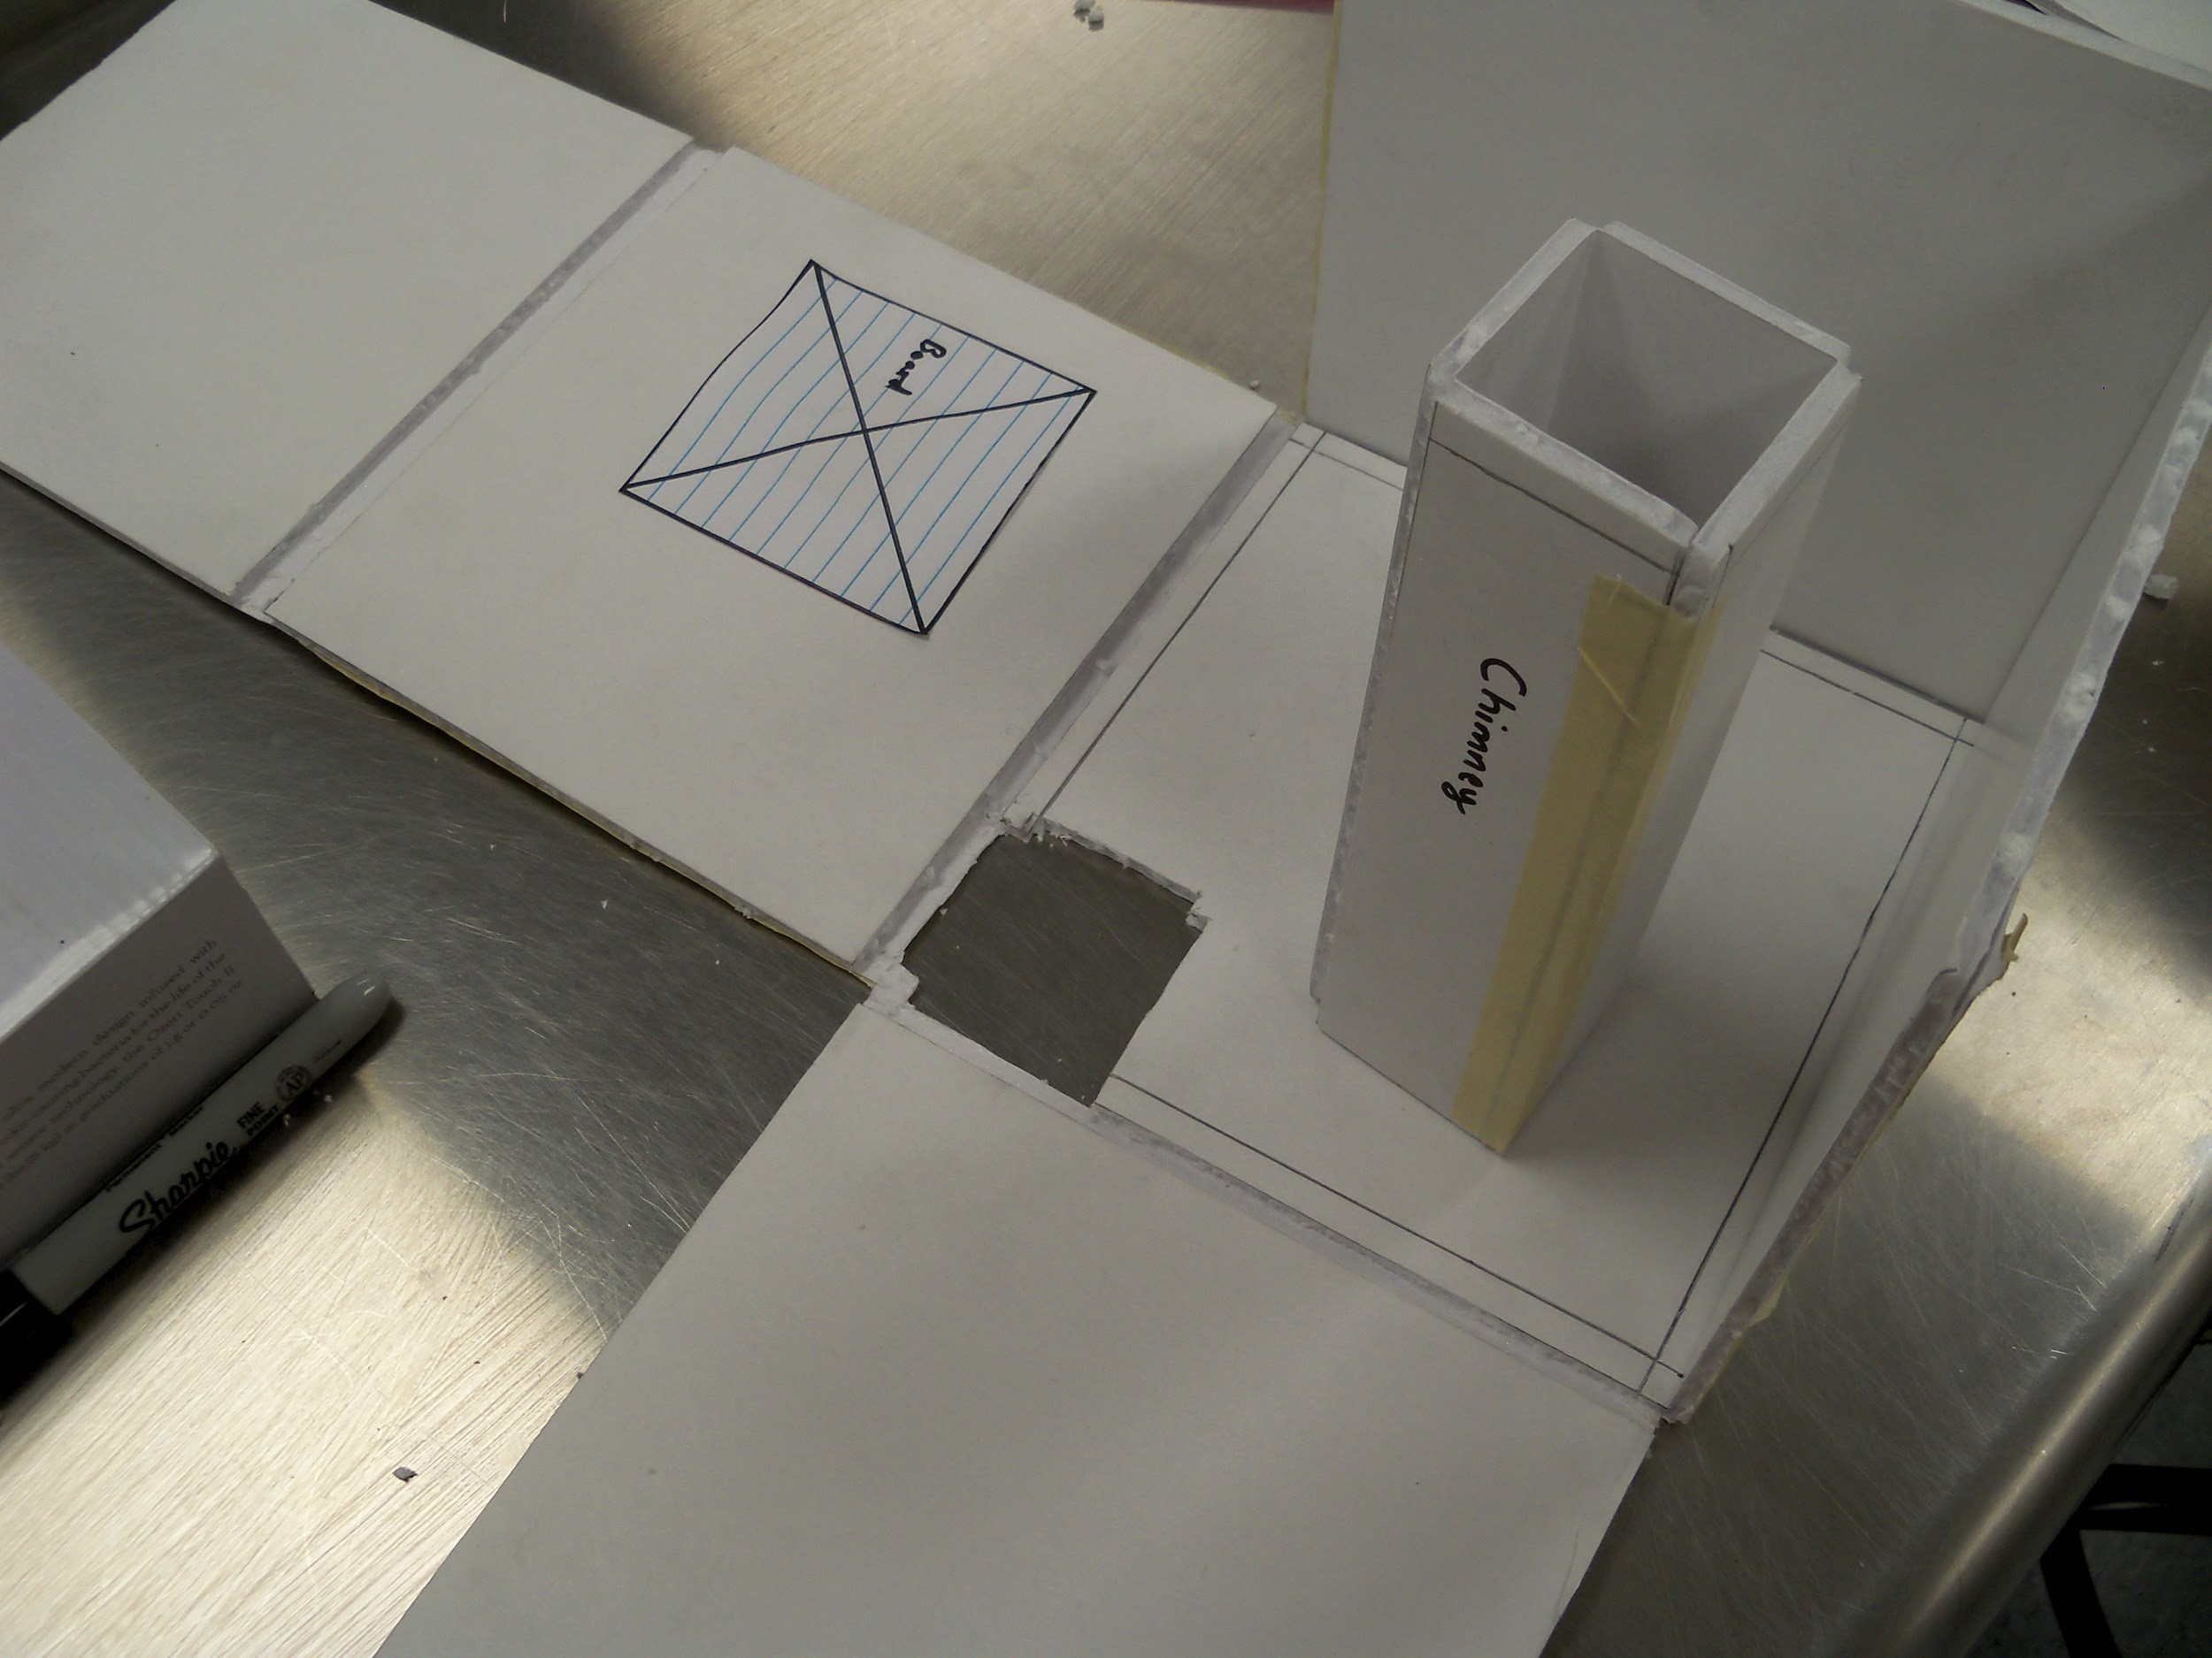
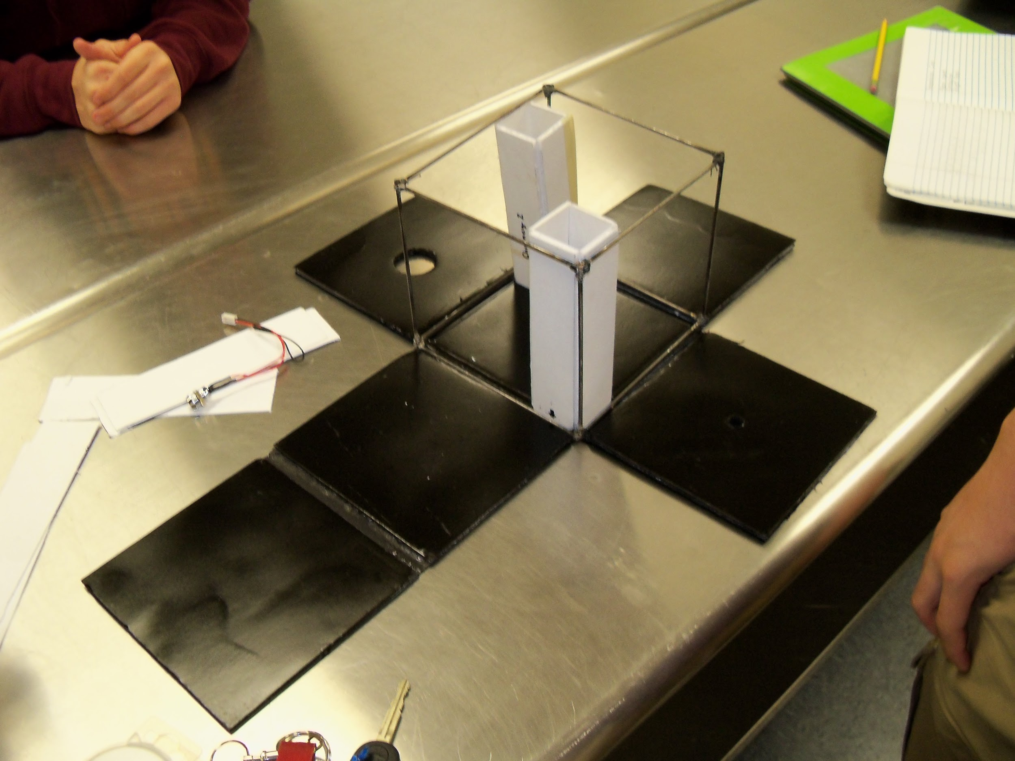
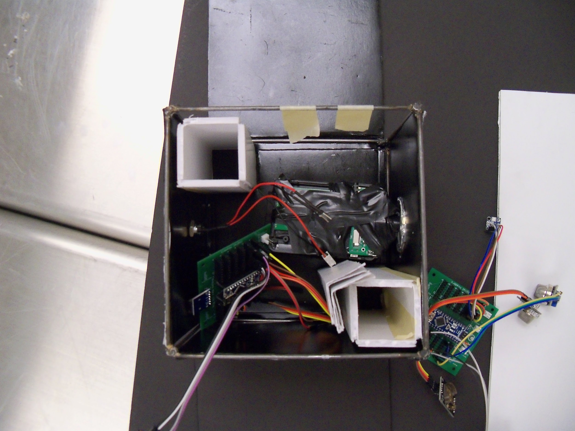
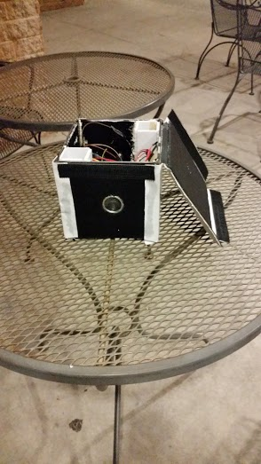
Design Stages of the Box
Sketching
Cutting and Shaving
Chimney
Holes and Placement
Spray Paint and Frame
Placement with Components
Adhesive and Insulation
Final Product

Slide 9
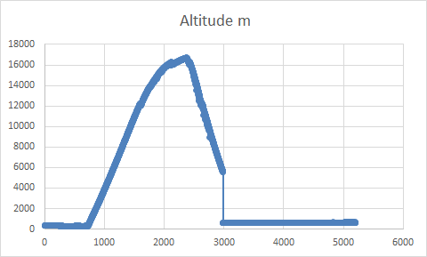
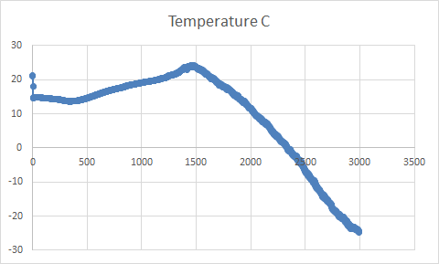
Results
Our sensor seems to have missed peak elevation by around 7 km (just under 4.5 mi, 22K feet). This could be caused by water getting into the barometer hole and freezing inside, thus blocking any accurate further pressure readings. This theory coincides with the temperature drop on the right.

Slide 10
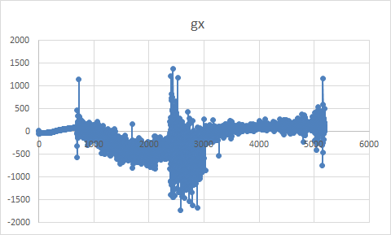
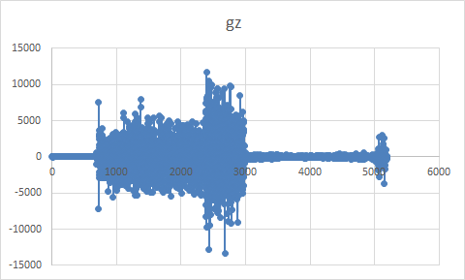
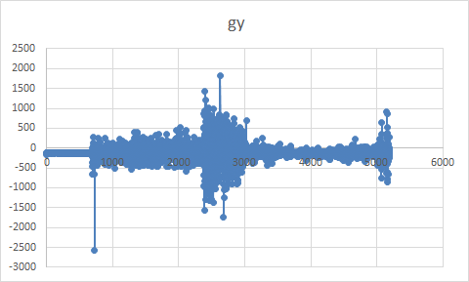
Results: Gyroscope
Our box shook too much as shown by the erratic gyroscope graphs in XYZ directions. If we are to use gyroscope in any future flights, we will implement a while loop in our code that will only take data that is consistent for a period of time, so the element of jerk will be less profound, and our data won’t look as erratic.

Slide 11
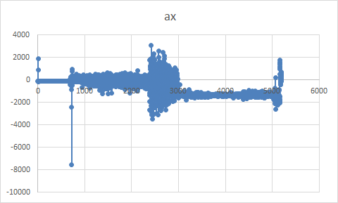
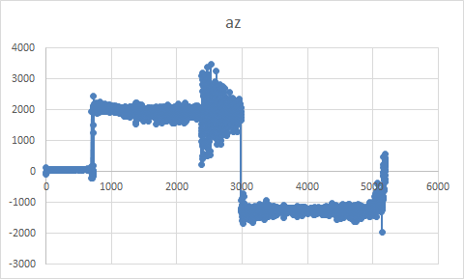
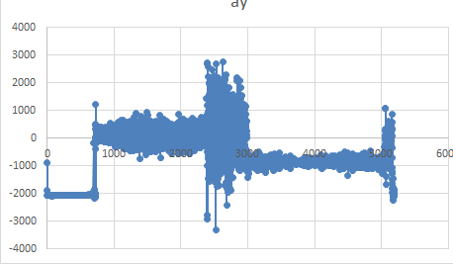
Results: Acceleration
Acceleration in the x direction did not change much prior to the pop of the balloon. after the balloon popped the acceleration jumped back and forth due to the spinning of the payload.acceleration for the y and z direction increased and stayed constant prior to the balloon pop. After the balloon popped the acceleration reversed but had a lower magnitude. We can conclude that the balloon ascended faster than it descended.

Slide 12
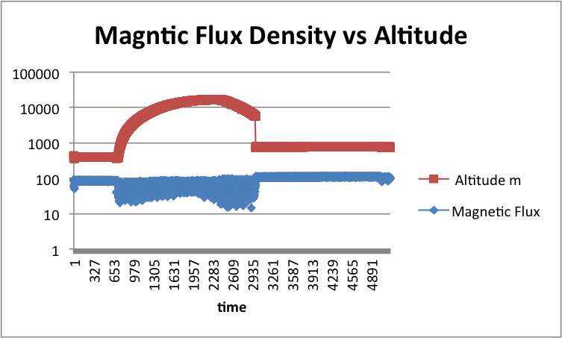
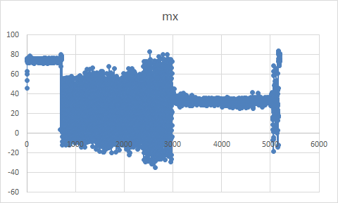
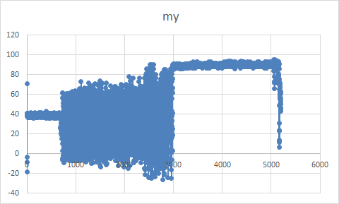
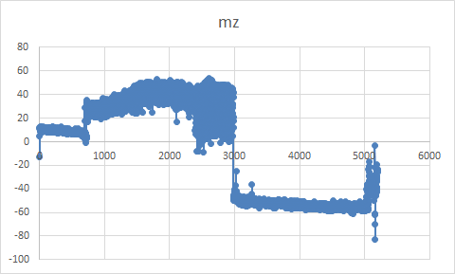
Results: Magnetic
Magnetic Flux Density = sqrt(mx^2+my^2+mz^2)
It seems that magnetic field was weaker as our payload was moving throughout the flight. Our data could be skewed because of magnetometer motion relative to the box itself. If the magnetometer was shaking, it could have been creating its own magnetic field and interfering with itself while data gathering. There is a possibility that some of our wires were too close to the magnetometer, creating a magnetic disturbance.

Slide 13
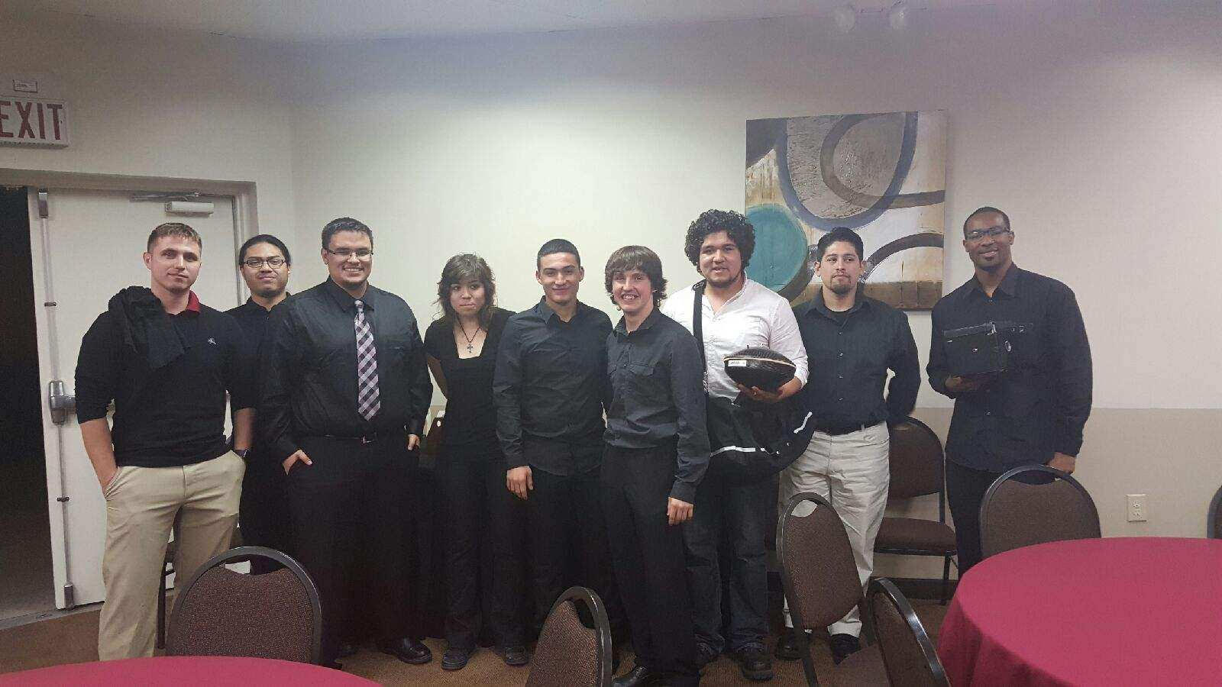
Future Plans Second Semester
For the second attempt, we decided to combine our groups to create one payload. With the overall total weight now being 3 pounds, we are given more freedom in choosing how many sensors we want, and what the structure of our payload can be. For this semester, we hoped to collect live data from different sensors, and record footage from different angled cameras throughout our payload.

Slide 14
Project Ascend
E=MC^2
Leroy Johnson
Jose Rincon
Andrey Bernov
Jonathan Hernandez
Vereniz Rincon
Daniel Hernandez
Saul Gonzalez
Lucas Madrid
Nick Quiros
Tommy Tran

Slide 15
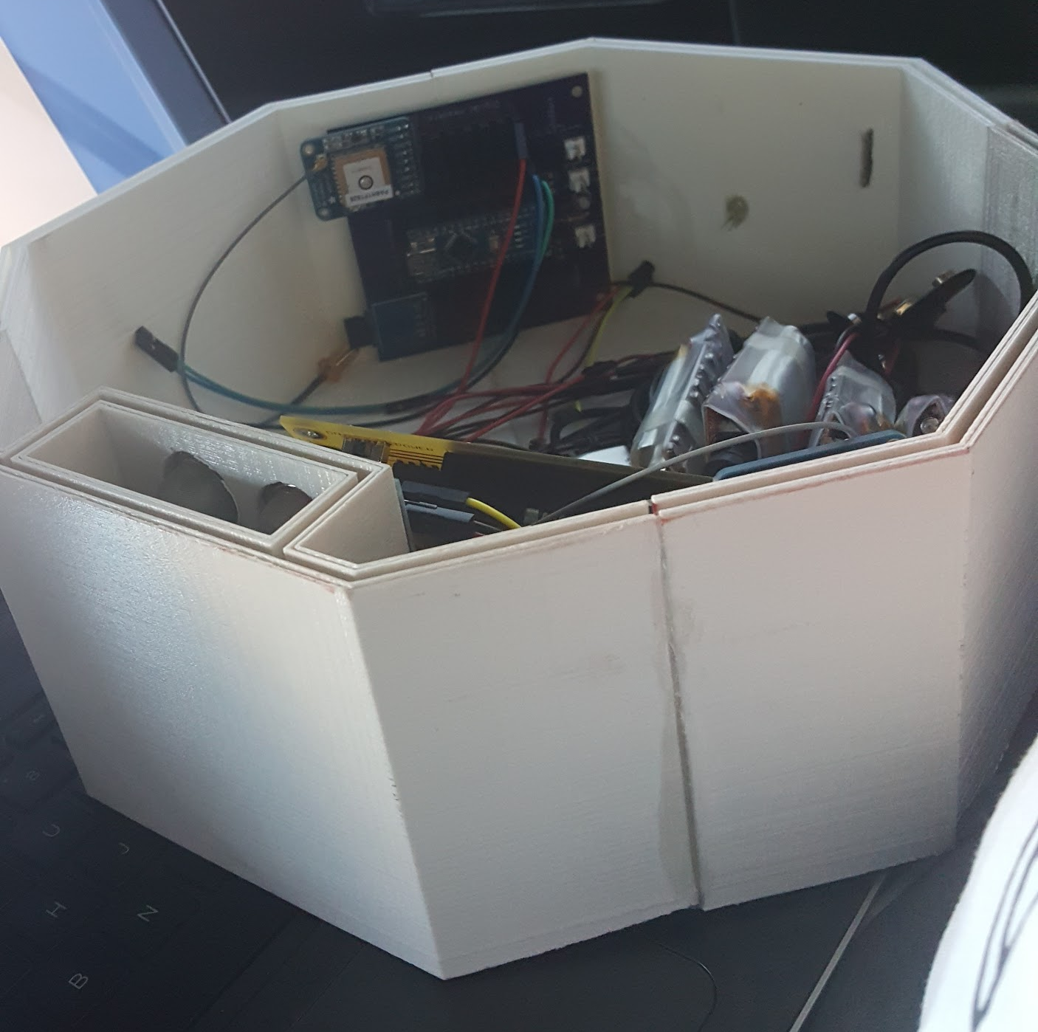
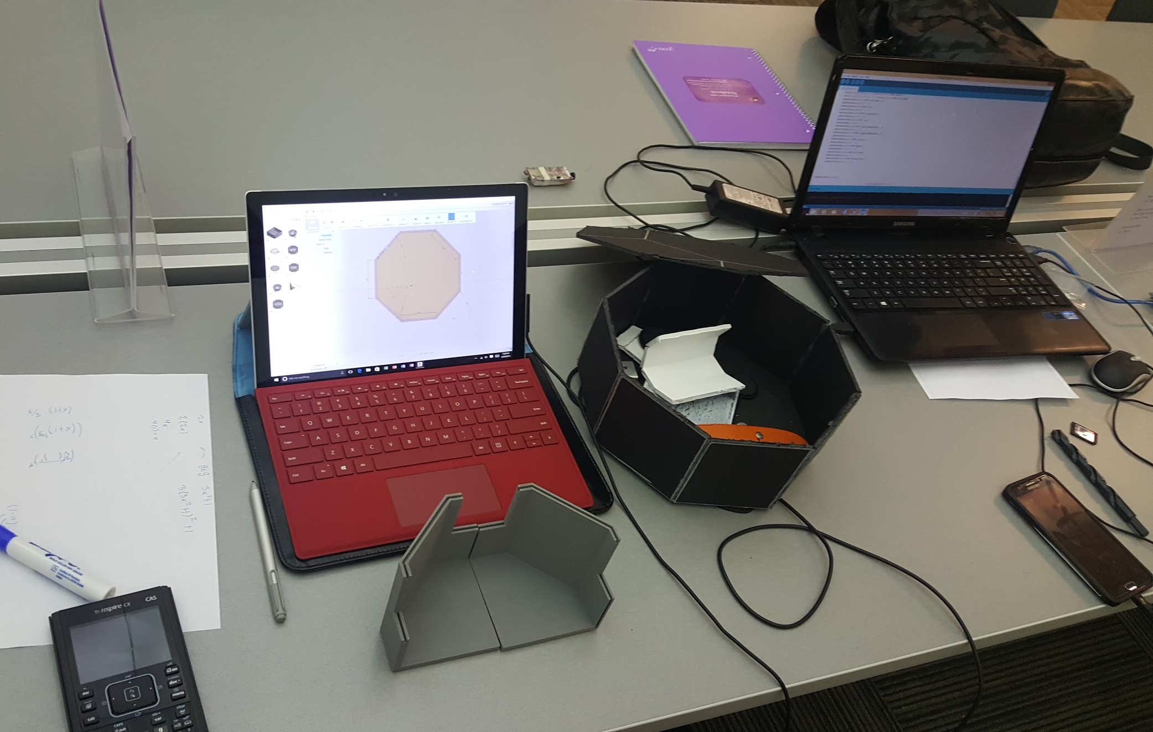
3D Structure
We decided to use the 3D printer to create our structure using the Autodesk Fusion 360. With this, we are able to fully customize the dimensions of our payload

Slide 16
3D Structure
One of the key features that we saw that we need to change was that it was more useful to have more length and width than height.
Therefore, we decided to make the structure wider and shorter to give use more real estate to put sensors and circuit boards.

Slide 17
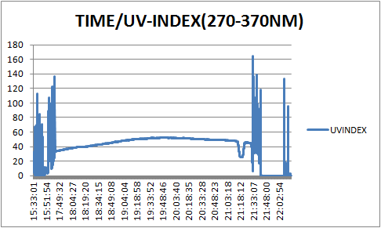
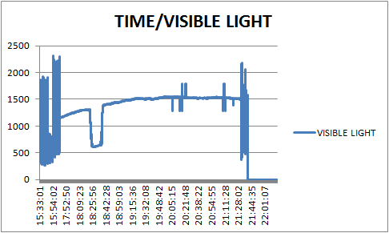
Sensor Analysis
Graph shows UV rays densely higher towards ground level than when at a higher altitude..
Same as UV, the light rays of the sun are more visible in ground level than when in launch.

Slide 18
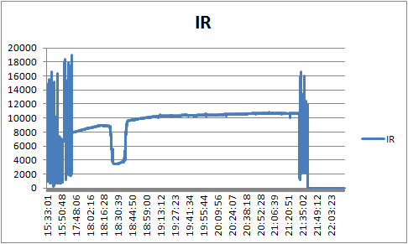
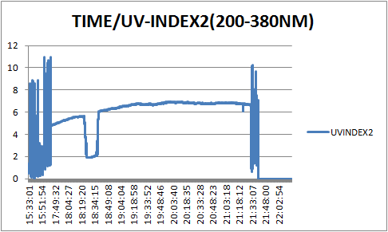
Sensor Analysis Cont...
With this sensor, we see the differentiation from ground level when it starts, to when it launches. Then back to ground level
Notes:
Sup

Slide 19
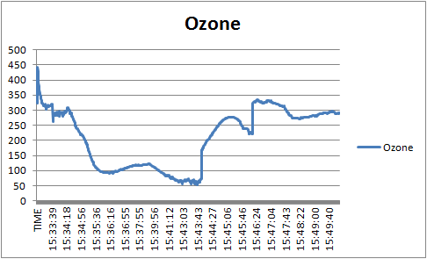
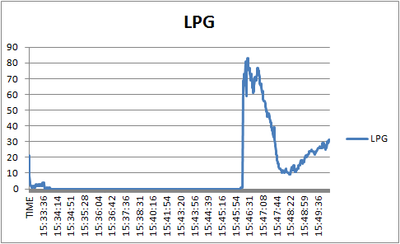
Gas Sensors
Our graph shows that ozone, or trioxygen, has many differentiating levels depending on the height. As for LPG, or widely known as propane gas, also has spike levels

Slide 20
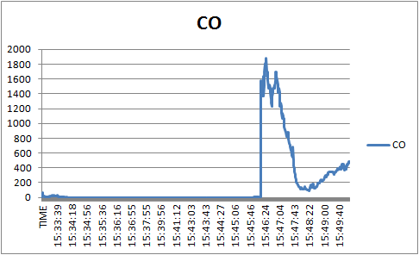
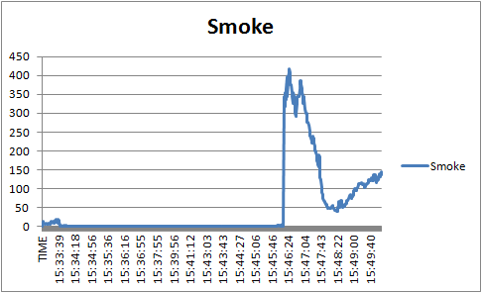
Gas Sensors Cont...
When these sensors went up in altitude, the CO and Smoke particles also went up

Slide 21
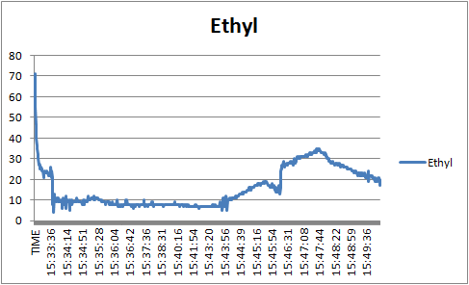
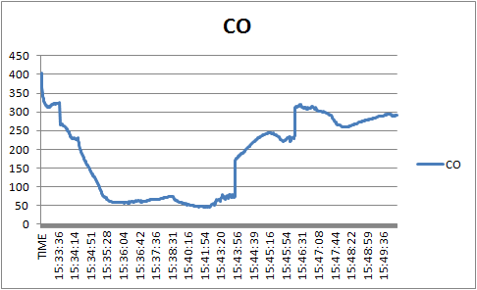
Gas Sensors Cont...
Differentiating Ethyl particles at ground level than at an increasing height.
Carbon monoxide readings show more particles at ground level than at high altitudes.

Slide 22
Conclusion
In conclusion, we see that when collecting readings starting from ground level, up to 90,000 feet, we projected that there would be differentiating levels. We realized that our temperature and altitude sensors data was incorrect. Our structure brought our sensors back in the same position we left them in. Everything was intact, and no damage was taken in the interior or exterior. Overall, we were happy with the data and video footage we collected.

Slide 23
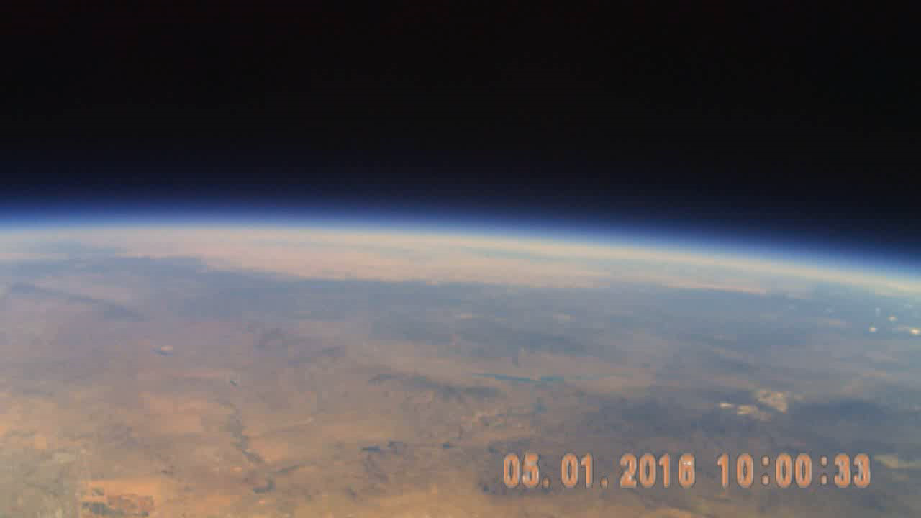
Highlights!
Before Pop

Slide 24
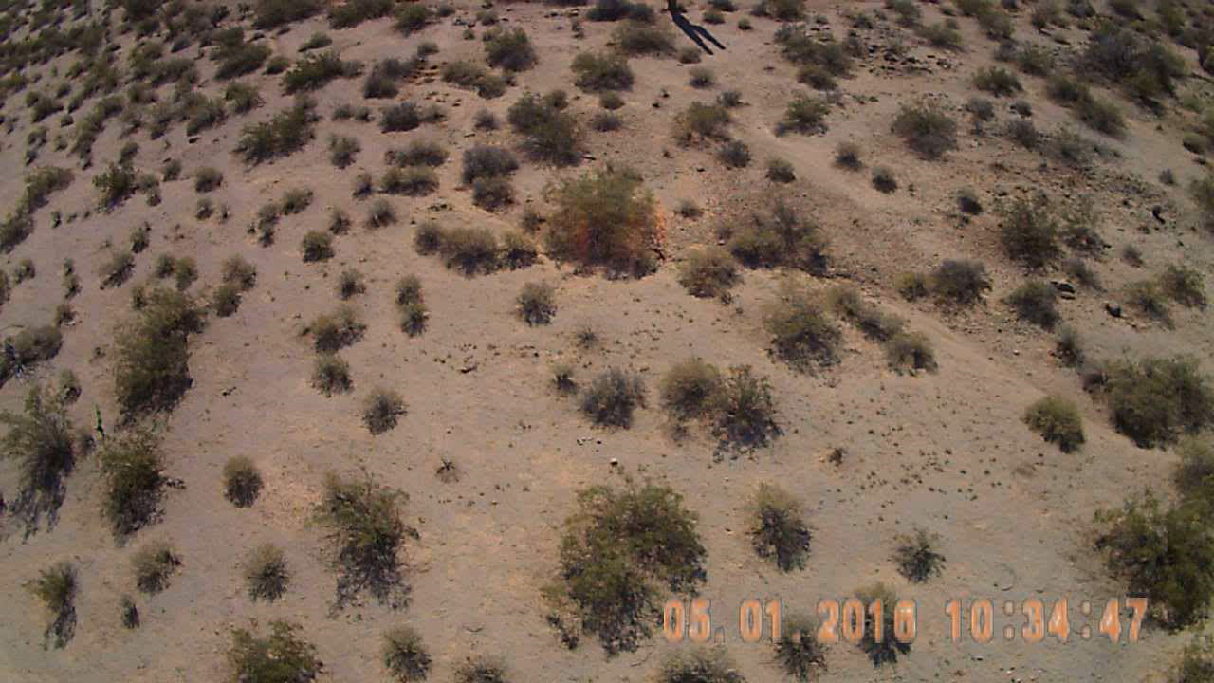
Before Landing

Slide 25
Questions?

